Slide 1
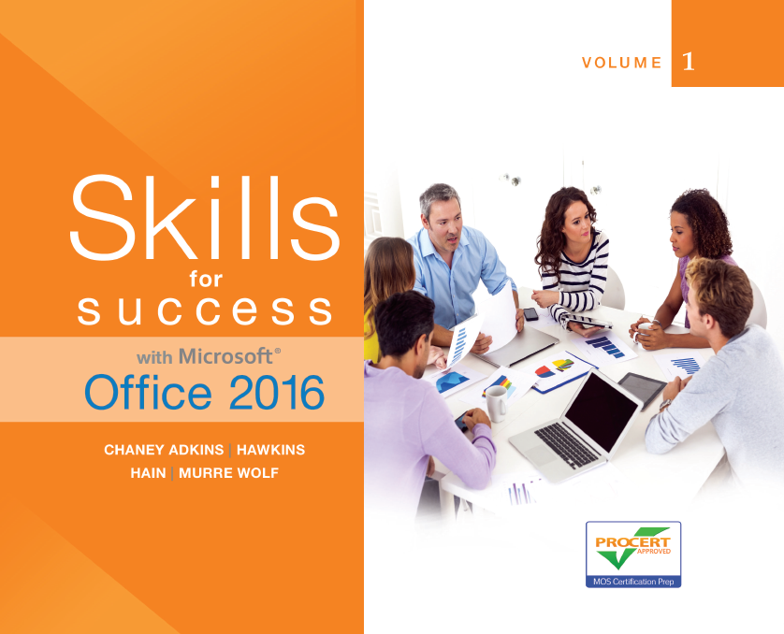
Skills for Success with Microsoft Office 2016 Volume 1
by Margo Chaney Adkins, Catherine Hain, Lisa Hawkins, and Stephanie Murre Wolf
Chapter 1
Getting Started with Computer Concepts
Notes:
Skills for Success with Microsoft Office 2016 Volume 1

Slide 2
Concepts
The Computer Is a System
Common Operating Systems
Input Devices
Storage Devices
Apps and Applications
Notes:
Because there is such a broad usage of computers in our work and personal life, it is important to be knowledgeable about computers—how they work and how to solve computer problems—and to be informed when purchasing a computer. This will enhance your career possibilities and make daily tasks easier.

Slide 3
Concepts (cont.)
Networks
Cloud Computing
Share Files with Others
Office 365
Buying a Computer
Notes:
Networking and cloud computing are good examples of easier and more cost-effective application and file usage.

Slide 4
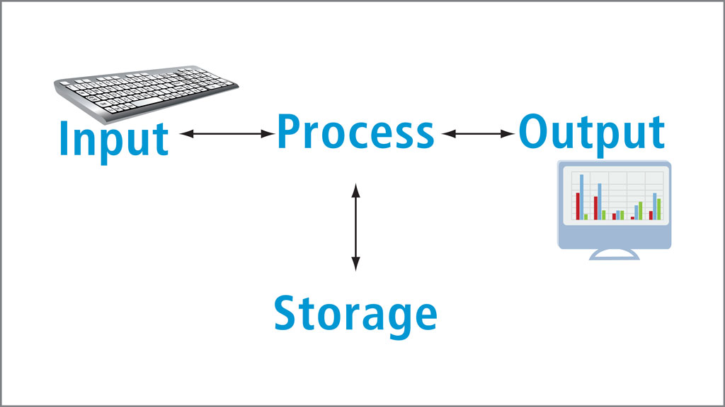
Concept 1: The Computer Is a System
Notes:
The computer is composed of hardware and software used to input, process, output, and store data. Certain hardware equipment and specific types of software are required to input and output data.

Slide 5
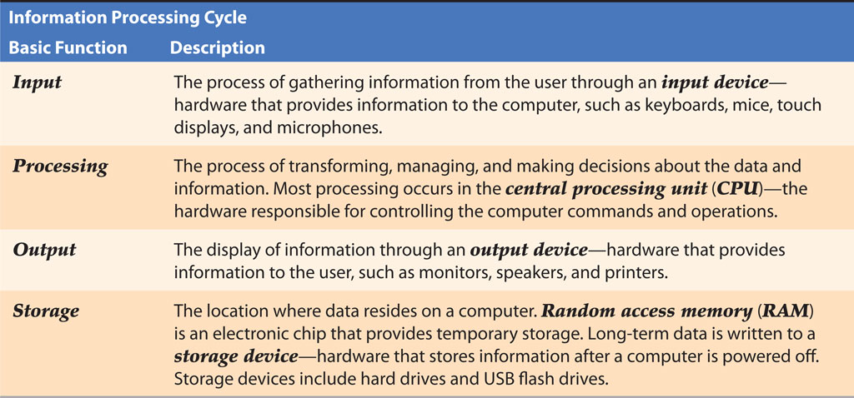
Concept 1: The Computer Is a System (cont.)
Notes:
The four basic functions of a computer system are common among all computers.

Slide 6
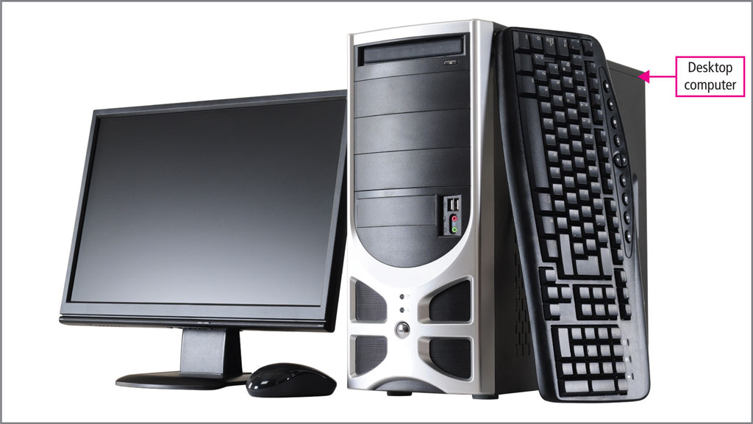
Concept 1: The Computer Is a System (cont.)
Notes:
The desktop computer is for non-mobile, stationary purposes. They typically have larger screen monitors and more computing power than other types of personal devices.

Slide 7
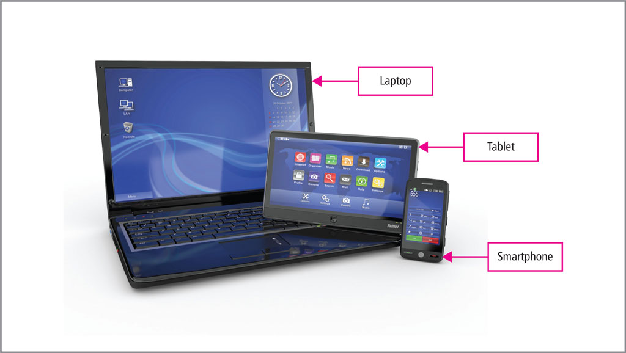
Concept 1: The Computer Is a System (cont.)
Notes:
Laptops, tablets, and smartphones are all examples of portable computing devices. Other types of computers are servers, which are dedicated to providing service to other computers on a network, and embedded computers, which are small, specialized computers built into larger components such as automobiles and appliances.

Slide 8
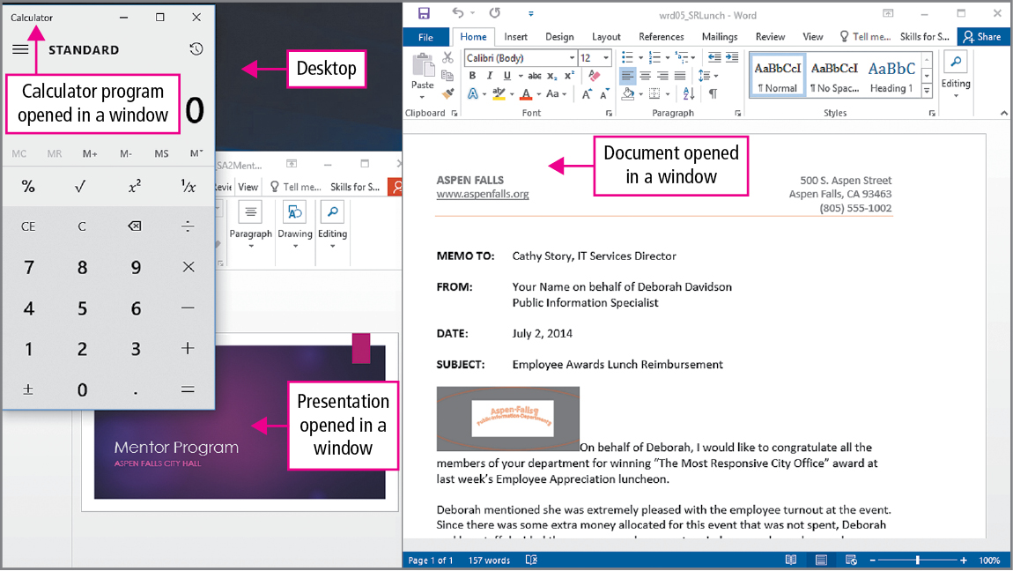
Concept 2: Common Operating Systems
Notes:
Most computers have a Graphical User Interface or, GUI, operating system. This provides icons, buttons, tiles, Windows, and dialog boxes. The desktop simulates a real desktop where files and folders can be placed.

Slide 9
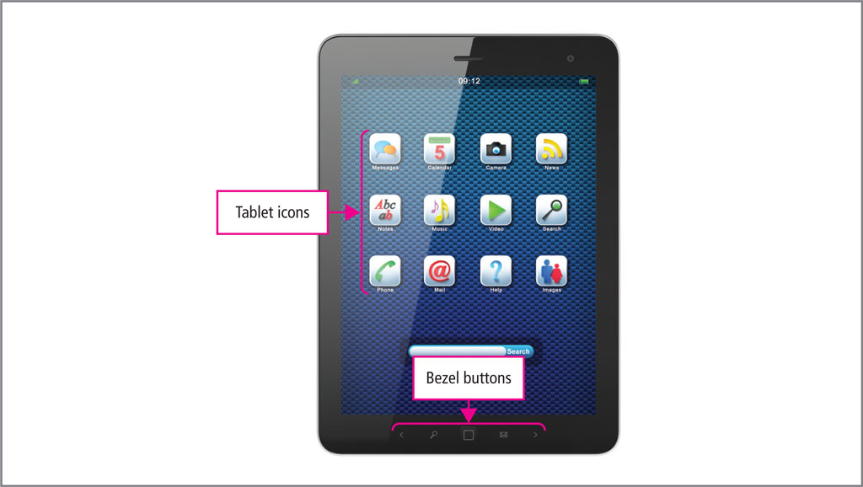
Concept 2: Common Operating Systems (cont.)
Notes:
Many operating systems such as tablets and smartphones do not provide a desktop. Mobile devices use icons or tiles on the screen.

Slide 10
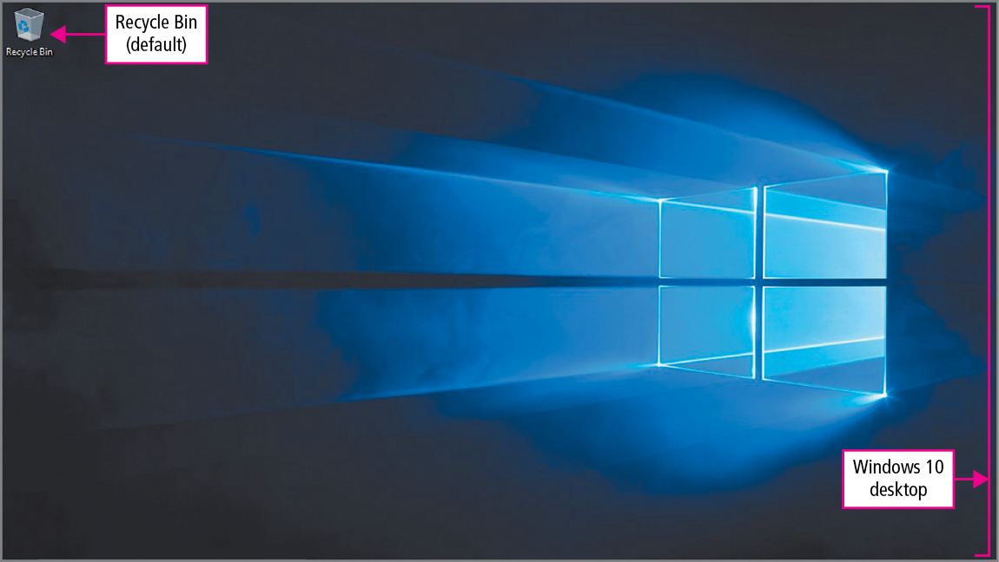
Concept 2: Common Operating Systems (cont.)
Notes:
Windows 10 provides a desktop, which is the screen that you see after logging in to your computer. The Windows 10 Start menu displays tiles. When you click or tap on a tile a larger view of the program fills the screen. By providing a Start menu and a desktop, Windows 10 can perform similarly on a desktop computer, laptop, tablet, or smartphone.

Slide 11
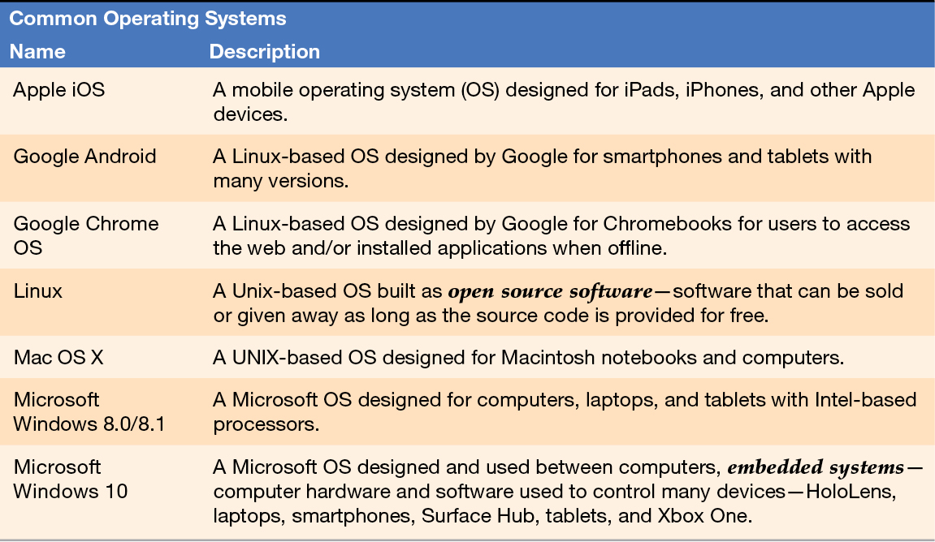
Concept 2: Common Operating Systems (cont.)
Notes:
The type of computer or device you are using will determine which operating system it will run. Utility programs are small programs designed to perform basic routine tasks or computer housekeeping chores.

Slide 12
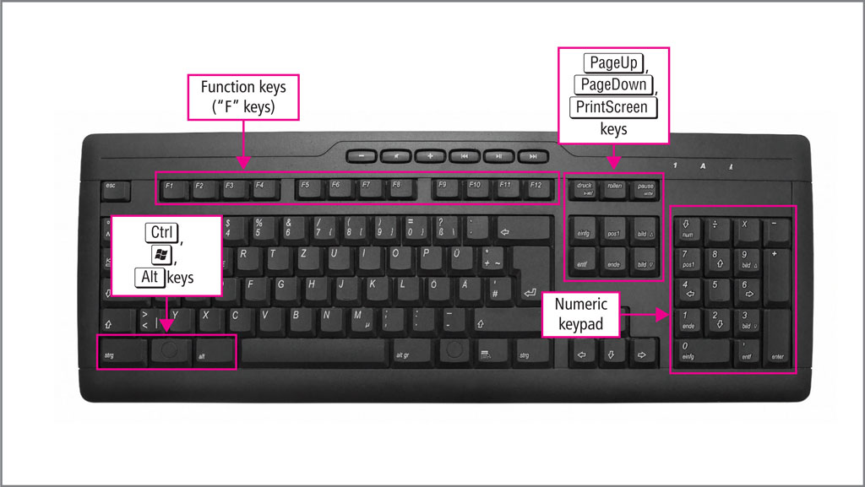
Concept 3: Input Devices
Notes:
Keyboards vary by manufacturer, but many share the same keyboard areas. In addition to typing, keyboard shortcuts can be used, which are combinations of character keys that perform commands when pressed.

Slide 13
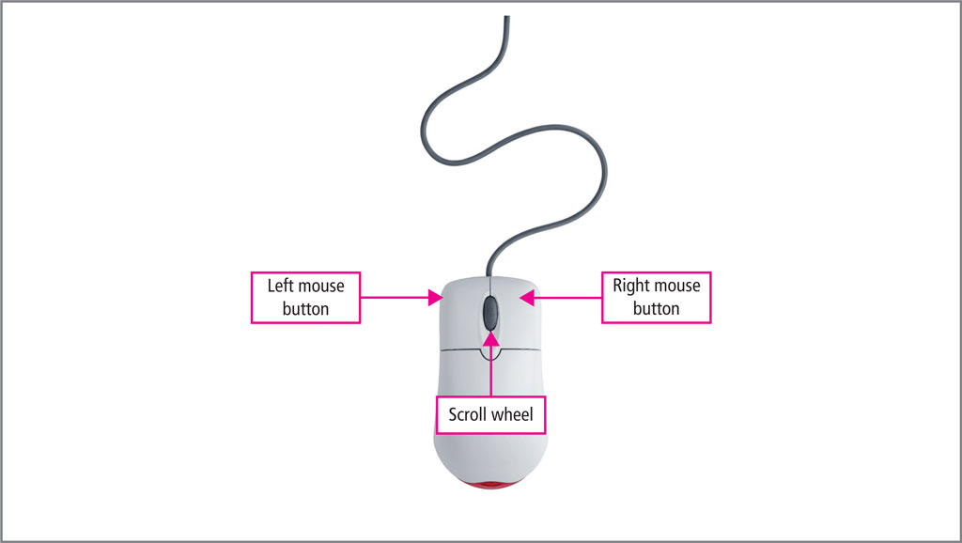
Concept 3: Input Devices (cont.)
Notes:
The mouse is an input device used to point to and click screen elements. Most mice have a right and left button, and a scroll wheel. Often, the right mouse button can be programmed to open drop-down menus and access other options.

Slide 14
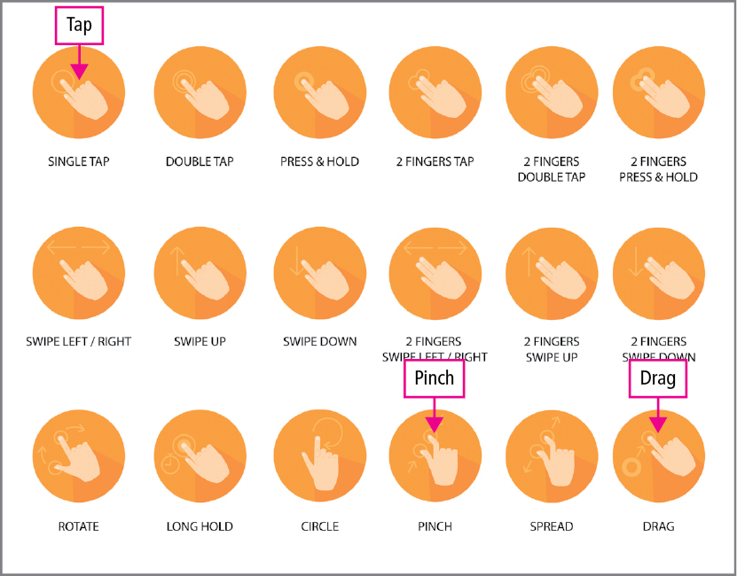
Concept 3: Input Devices (cont.)
Notes:
Many computers have built-in touchpads, which are flat areas on which you can move your finger to position the pointer. Touchscreens can accept input when you touch them with your finger or a stylus. Touchscreens use gestures or body motions that are interpreted as commands.
Other types of input devices includes voice or speech recognition, cameras, scanners, and fingerprint scanners.

Slide 15
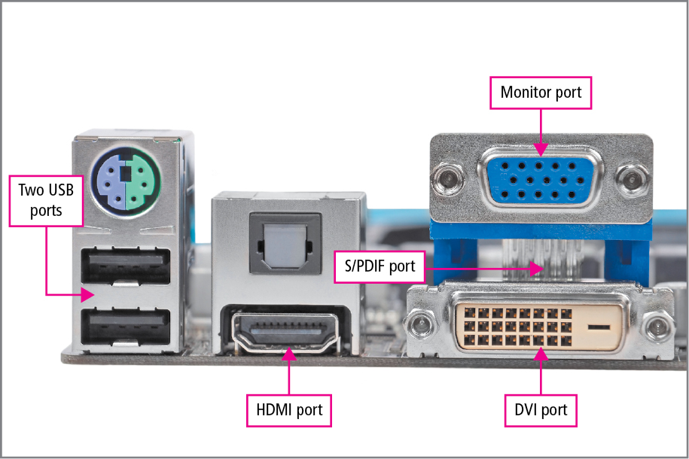
Concept 3: Input Devices (cont.)
Notes:
Ports are connectors on the outside of a computer to which external devices can be connected. Different ports are used for different devices.

Slide 16
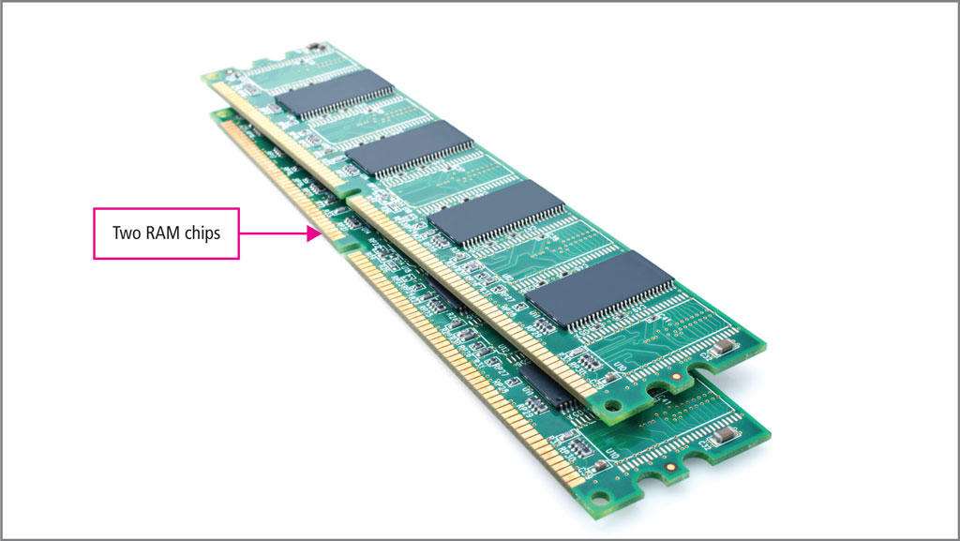
Concept 4: Storage Devices
Notes:
There are two types of memory storage in a computer—short-term and long-term. Random Access Memory or, RAM, is the short-term memory and is found within the computer. These chips maintain data only when there is power to the computer.

Slide 17
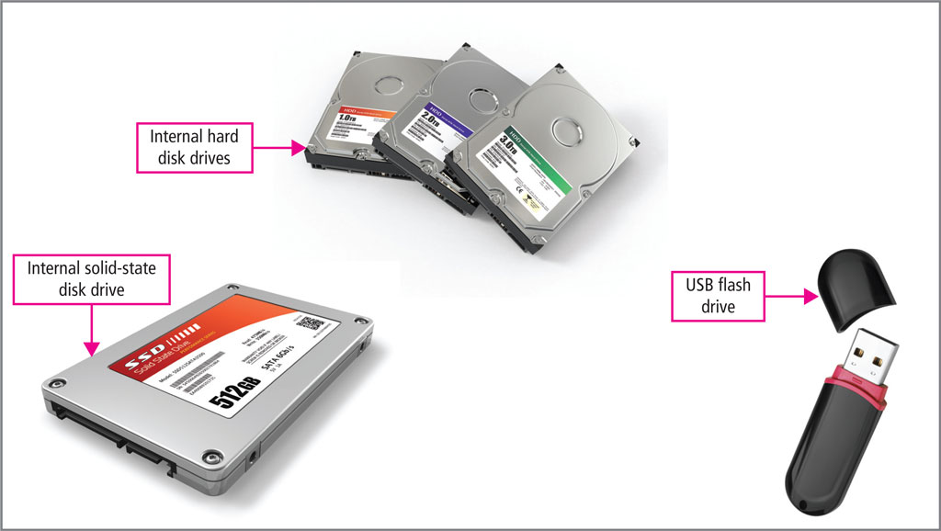
Concept 4: Storage Devices (cont.)
Notes:
Long-term storage devices include internal hard disk drives and flash memory devices. They both retain data when the power is turned off. Internal solid-state drives are faster than magnetic drives. When a solid-state drive attaches to the computer via a USB port, it is often referred to as an external drive. A USB flash drive is a small, portable solid-state drive that is often referred to as a thumb drive.
Other storage devices include DVDs, which uses an optical laser to read and write data, and flash-based memory cards, such as those used in cameras and video recorders.

Slide 18
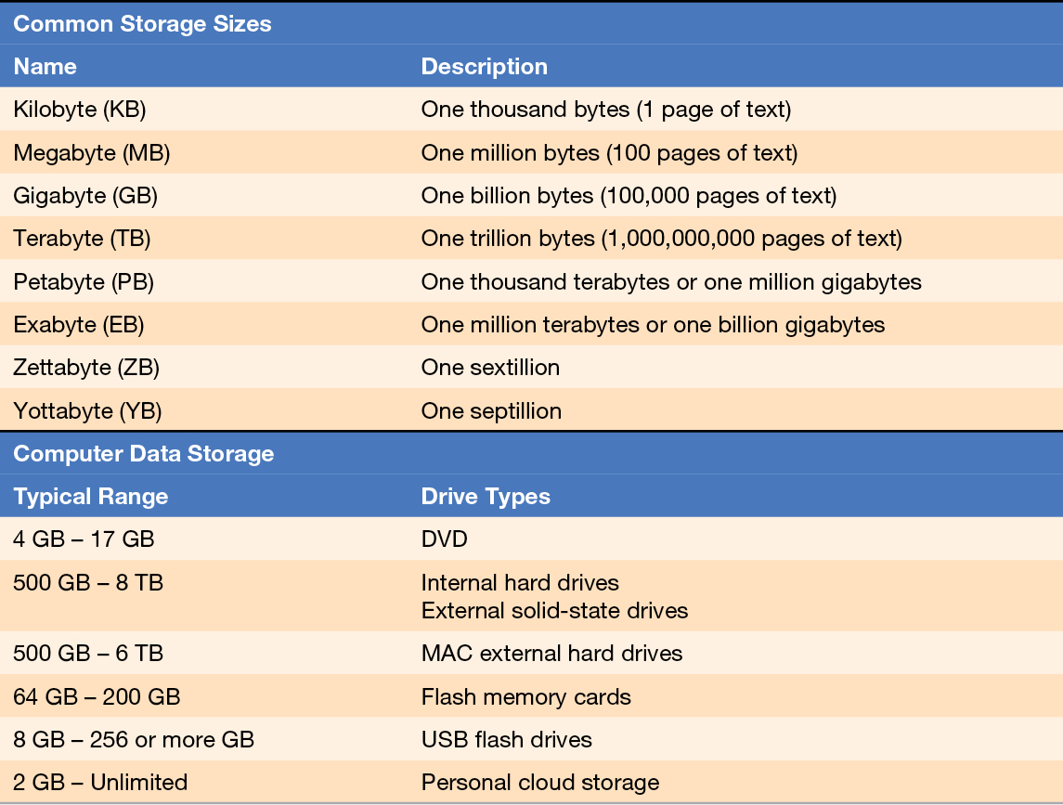
Concept 4: Storage Devices (cont.)
Notes:
Most storage devices measure their capacity in either gigabytes or terabytes. A 1TB hard drive can store approximately 1,000,000 digital photos.

Slide 19
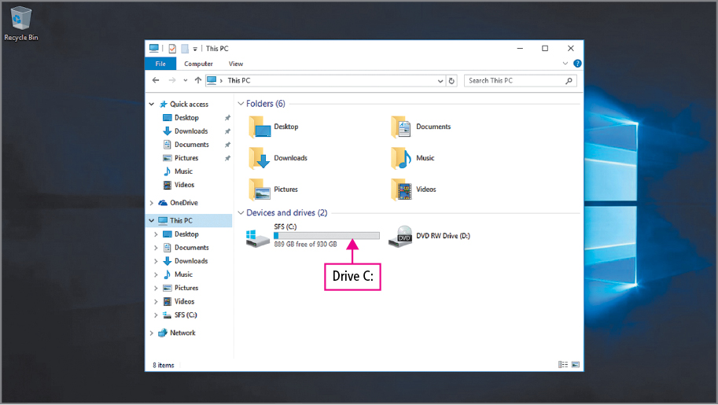
Concept 4: Storage Devices (cont.)
Notes:
You can identify a storage device in the Windows file system by a unique letter that is assigned to it. The internal drive that stores the operating system is referred to as the C drive. Network drives are used by large organizations and are hard drives that are accessed through a network such as a business or a school.

Slide 20
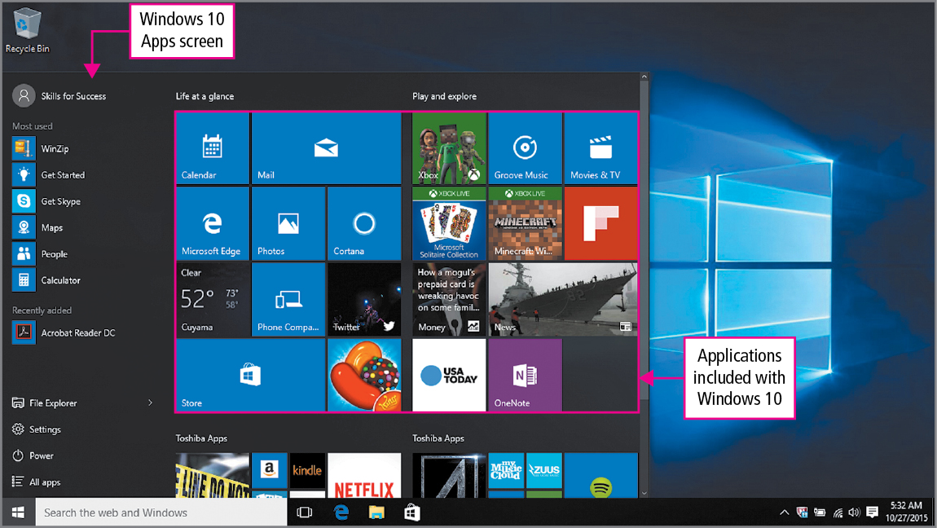
Concept 5: Apps and Applications
Notes:
Most operating systems include software to complete common tasks such as word processing or spreadsheet calculations. Some applications are included with Windows 10. Other applications can be purchased separately. Many applications found in commercial software are also offered as free or open source software. Caution must be exercised to make sure the free software source is secure and can be trusted.

Slide 21
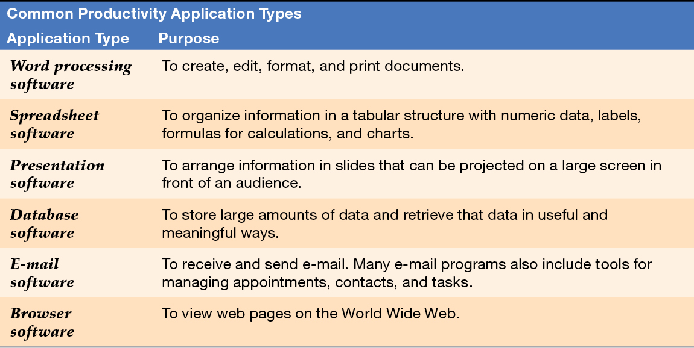
Concept 5: Apps and Applications (cont.)
Notes:
Productivity software is used to accomplish a task, such as reading and writing email, writing documents, and managing tasks.

Slide 22
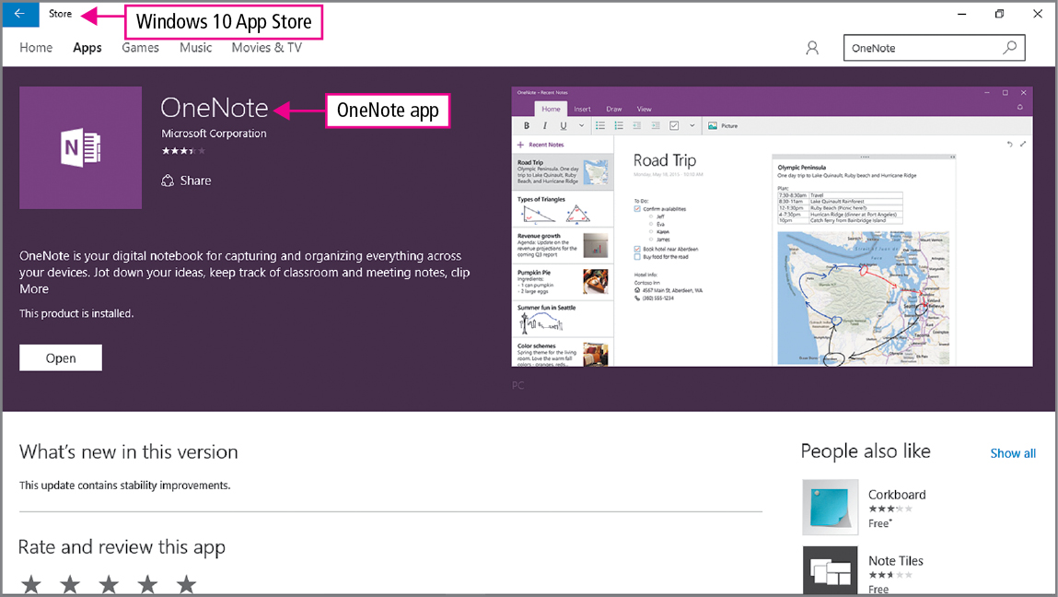
Concept 5: Apps and Applications (cont.)
Notes:
The term app refers to a program purchased through a computer or personal device. These programs are smaller and less expensive than traditional applications found on your laptop or desktop. Apps have fewer features and a different interface than the desktop application that runs on a desktop window.

Slide 23
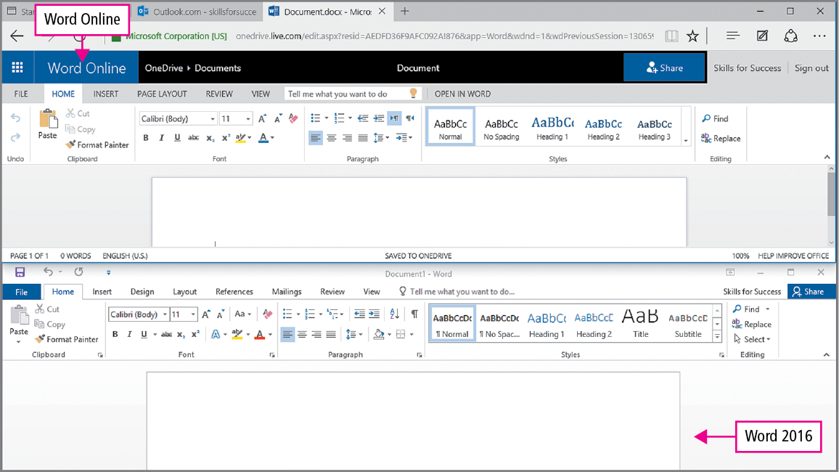
Concept 5: Apps and Applications (cont.)
Notes:
Software instructions stored in a program are designed to work with specific operating systems and hardware. Smartphone apps are typically written for iOS, Android, or Windows 8.1 phones. Desktop applications are often written for Windows, System X, or Linux. When using Microsoft Word on a Mac, the program is similar but not identical to the version running on a Windows computer.

Slide 24
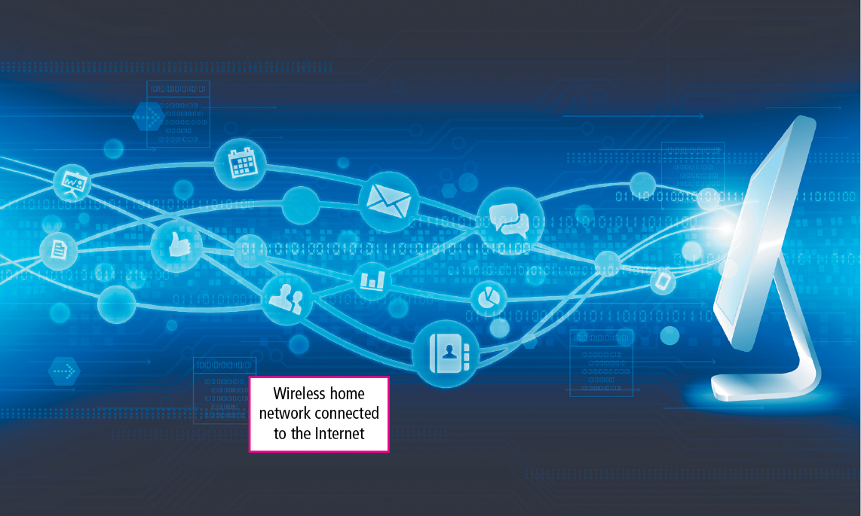
Concept 6: Networks
Notes:
Networks are a system of hardware and software that connects computers and devices. Wired networks require cabling and transmit signals through wires. Wireless networks transmit signals via radio waves without the need of wires. Wired networks are faster for data transfer and more secure than wireless networks.

Slide 25
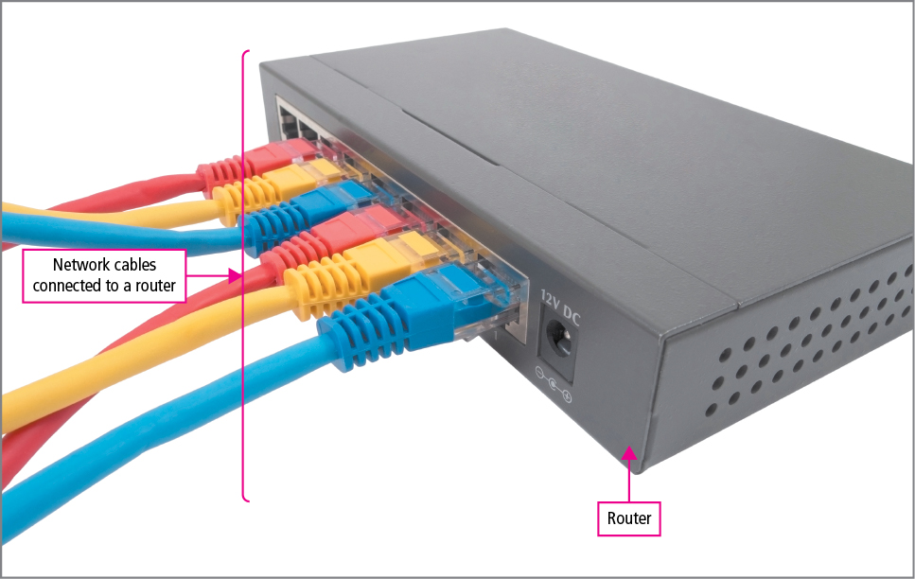
Concept 6: Networks (cont.)
Notes:
Every network device needs a Network Interface Card, or NIC. A wired NIC has a port for an RJ-45 connector. Wireless NICs have antennas for sending and receiving radio waves. Both the wired and wireless devices will need to be connected to a router, which is a network device with which computers on networks communicate.

Slide 26
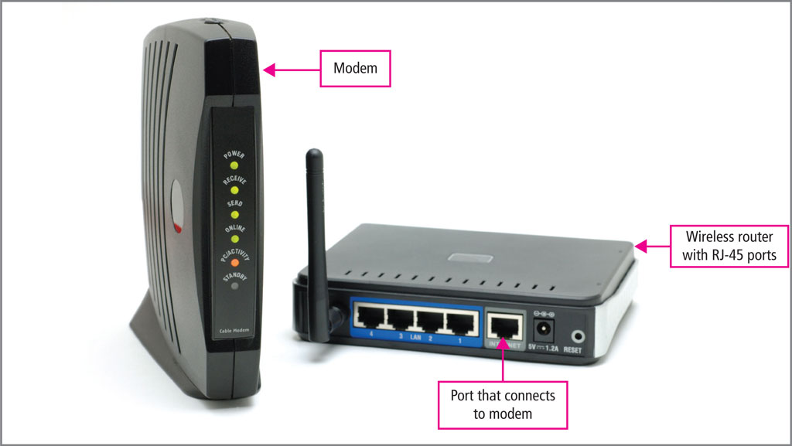
Concept 6: Networks (cont.)
Notes:
To connect to the Internet, you will need to subscribe to an Internet Service Provider, or ISP. This is a company or organization that provides Internet connections typically for a fee. The router needs to be connected to a modem, which is a device that translates signals between a router and an ISP.

Slide 27
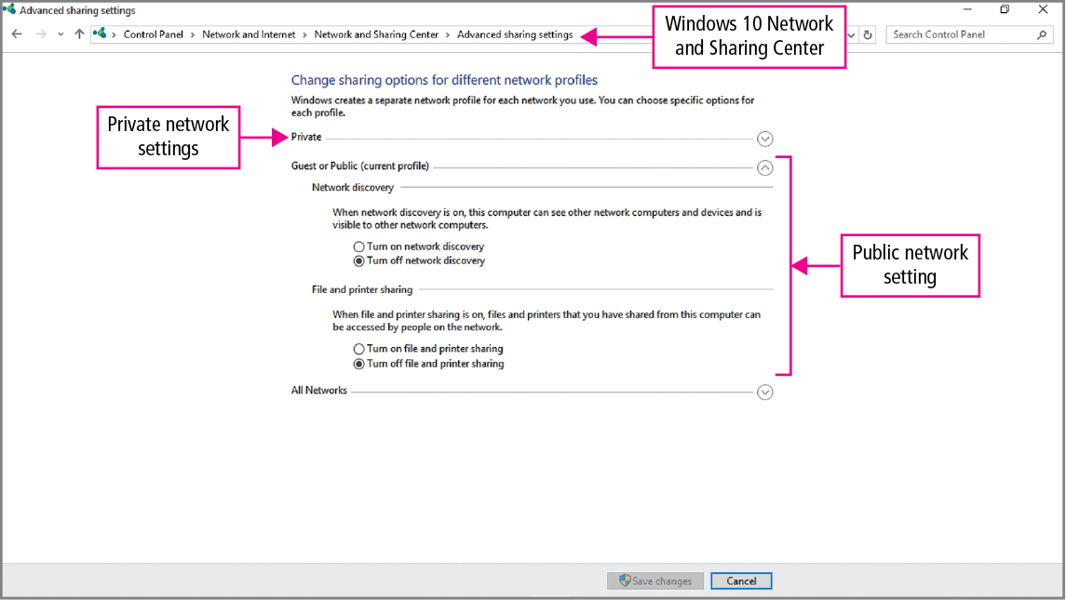
Concept 6: Networks (cont.)
Notes:
There are secured and unsecured networks. An unsecured network does not require a password to connect to it. Caution must be used when accessing unsecured networks because sensitive data such as usernames and passwords to other networks may be compromised. You should always secure your own wireless network with a strong password.

Slide 28
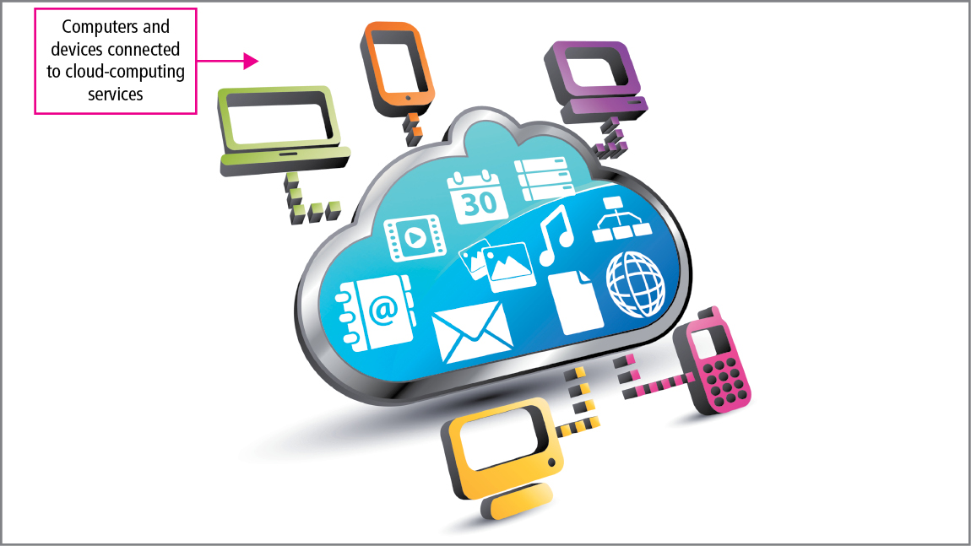
Concept 7: Cloud Computing
Notes:
Cloud Computing is a service that can provide file storage or an application via the Internet. Several advantages to Cloud Computing include the accessibility of files and programs for multiple devices. Cloud Computing also offers security if a device is lost or stolen.

Slide 29
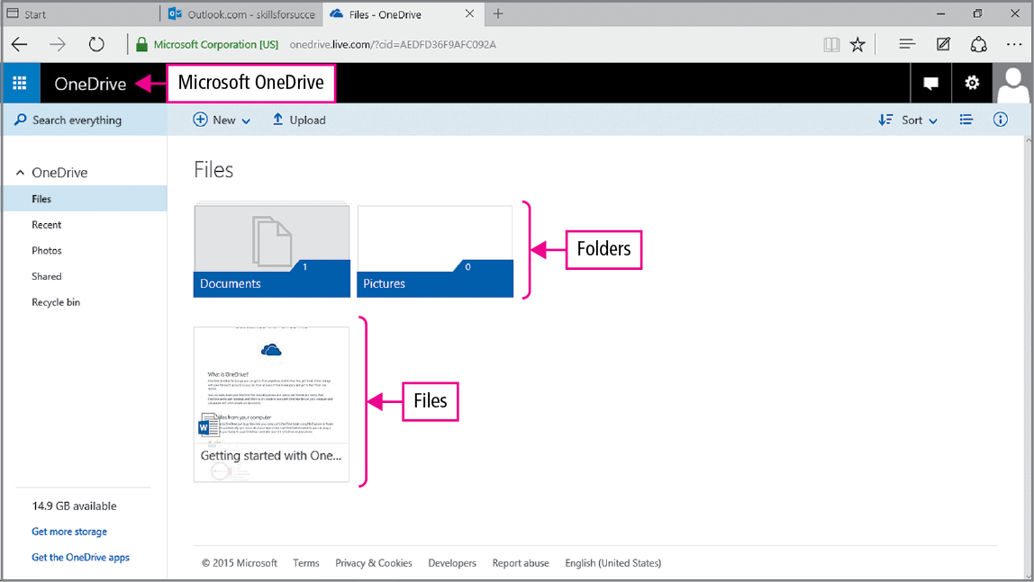
Concept 7: Cloud Computing (cont.)
Notes:
Cloud storage works similarly to files stored on your regular computer. You can save and open files stored on the Cloud instead of your local hard drive.

Slide 30
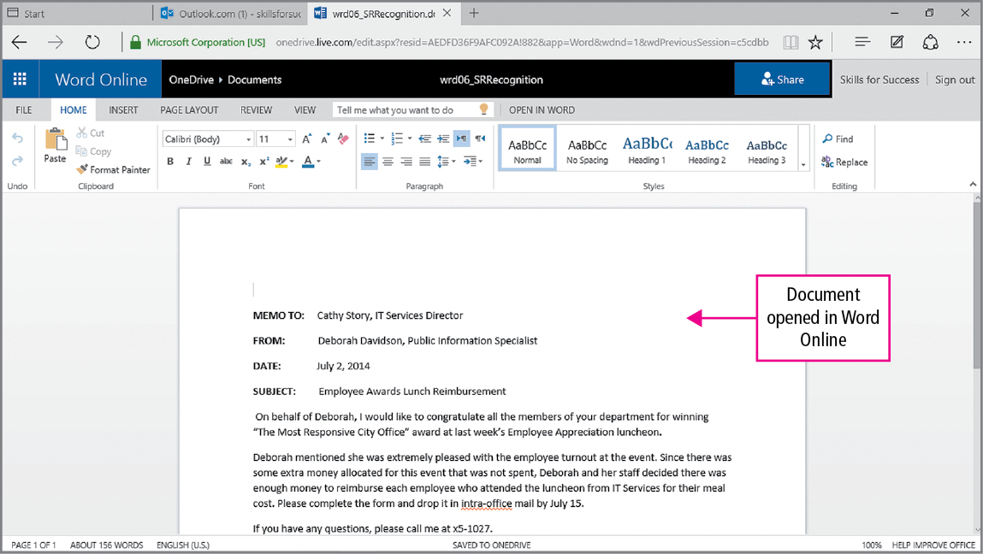
Concept 7: Cloud Computing (cont.)
Notes:
Web apps are programs that run in a web browser and are useful when you need to edit and apply basic formatting from a computer that does not have a desktop application. Streaming media is an example of a cloud-based service that provides video and music as you watch or listen to it. The media is stored on the Cloud, not your internal hard drive.

Slide 31
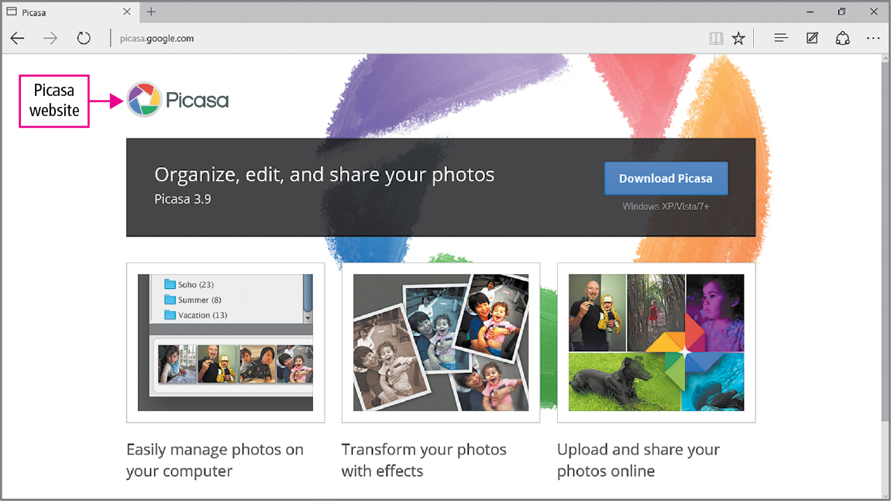
Concept 7: Cloud Computing (cont.)
Notes:
Services that make copies of your files to a server are called Cloud Backup. You can change and move your backup files to different devices easily. Web albums are cloud-based services that store, organize, and share photos and videos. By using a cloud-based service, photos and videos are available anywhere a device can connect to the Internet.

Slide 32
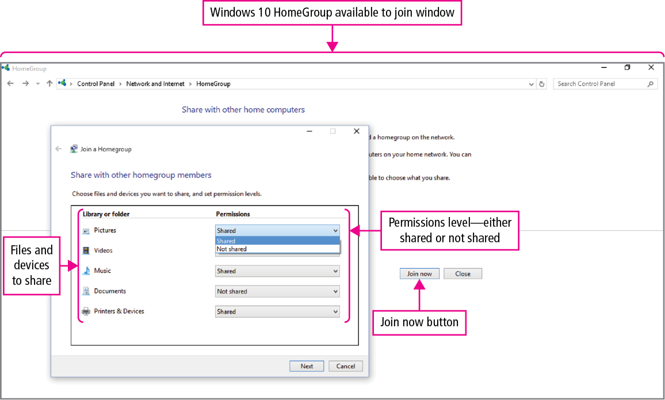
Concept 8: Share Files with Others
Notes:
A network, the Internet, and Cloud computing are used to share files and other data. HomeGroup is a Windows networking tool that makes it easy to share pictures, videos, music, documents, and even devices such as printers. When files are shared, a password is required to read, rename, and delete or change a file. Different permission levels are granted based upon the desire to perform certain functions.

Slide 33
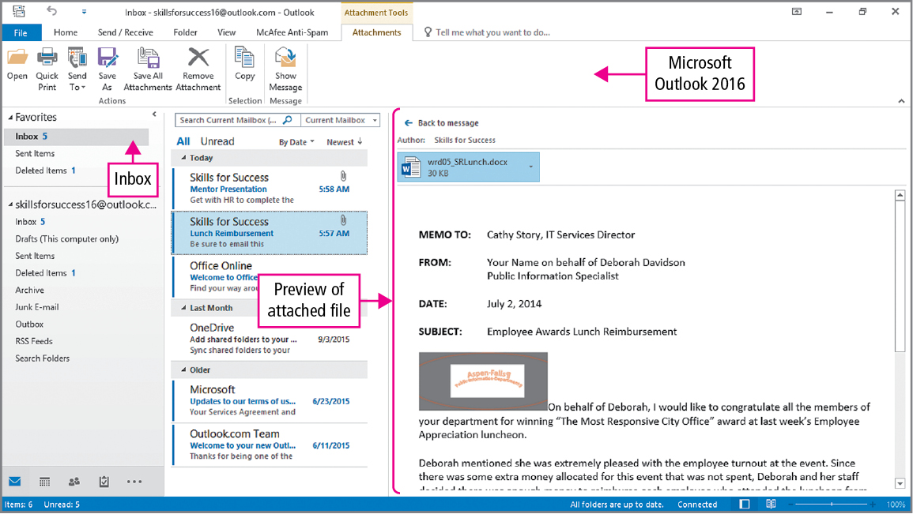
Concept 8: Share Files with Others (cont.)
Notes:
Electronic mail, or email, can be used to share text, pictures, and files. Files can be attached to email messages or embedded into the actual message.

Slide 34
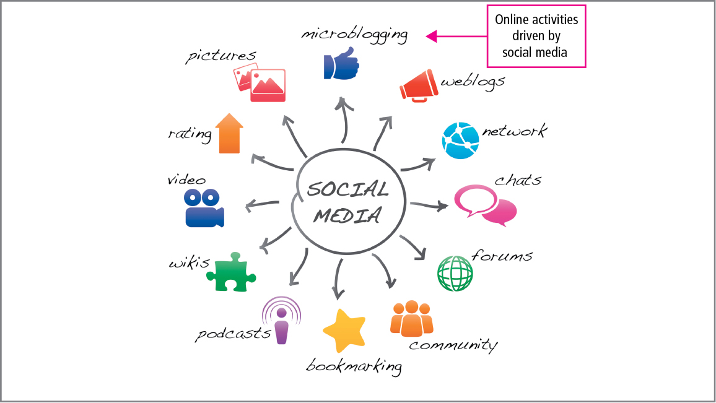
Concept 8: Share Files with Others (cont.)
Notes:
Social media is a cloud service that allows information to be shared through the interaction of people using social networks. The sharing of data is limited to those who are allowed access. Because of social networking, content may also be viewed by millions of people.

Slide 35
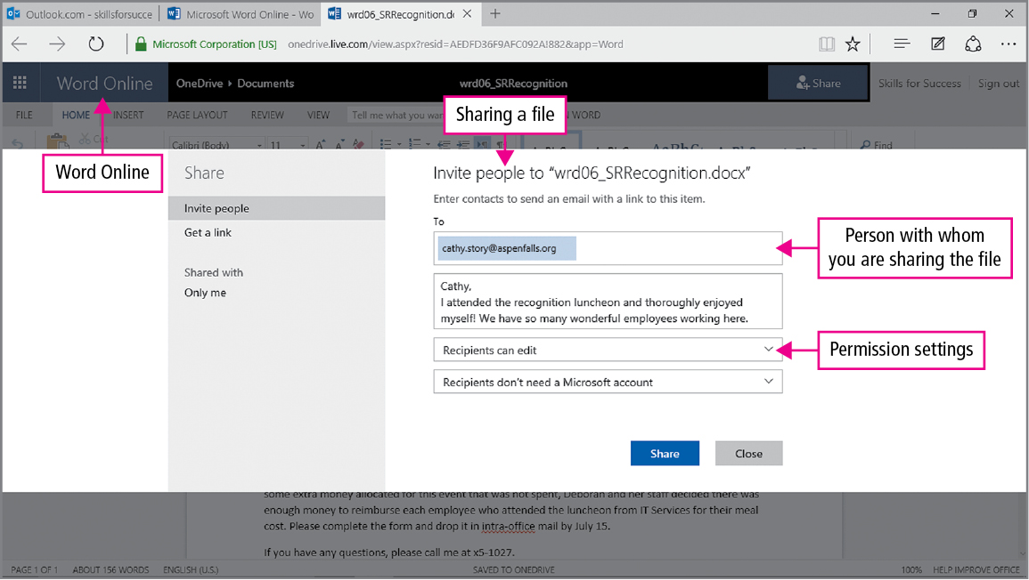
Concept 8: Share Files with Others (cont.)
Notes:
Sharing files via the Cloud makes it easy for viewers to make changes to the files and see what changes have been made by others. OneDrive files are shared by posting a link to your social media account, such as Facebook or Twitter. Those who can see your posts can follow the link to open the document.

Slide 36
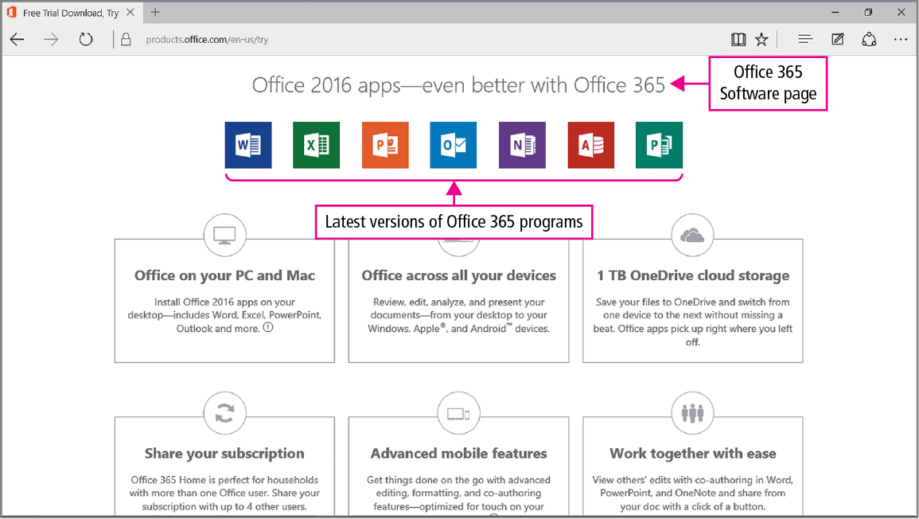
Concept 9: Office 365
Notes:
Office 365 is a cloud-based service built around the Office suite of programs. It combines traditional office desktop applications with Cloud services. Programs can be purchased separately via a subscription, and the cost of a subscription is dependent on the number of users and types of services required.

Slide 37
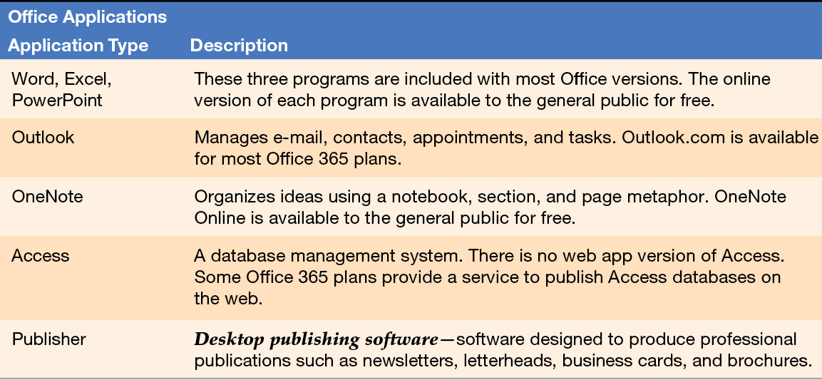
Concept 9: Office 365 (cont.)
Notes:
Subscriptions to Office 365 provide additional office applications that are not included in different versions or editions of Microsoft Office such as home and small business editions. Most subscription plans also include Office for Mac. Office on Demand is a streaming version of Microsoft Office that can work with a computer that does not have Office installed.

Slide 38
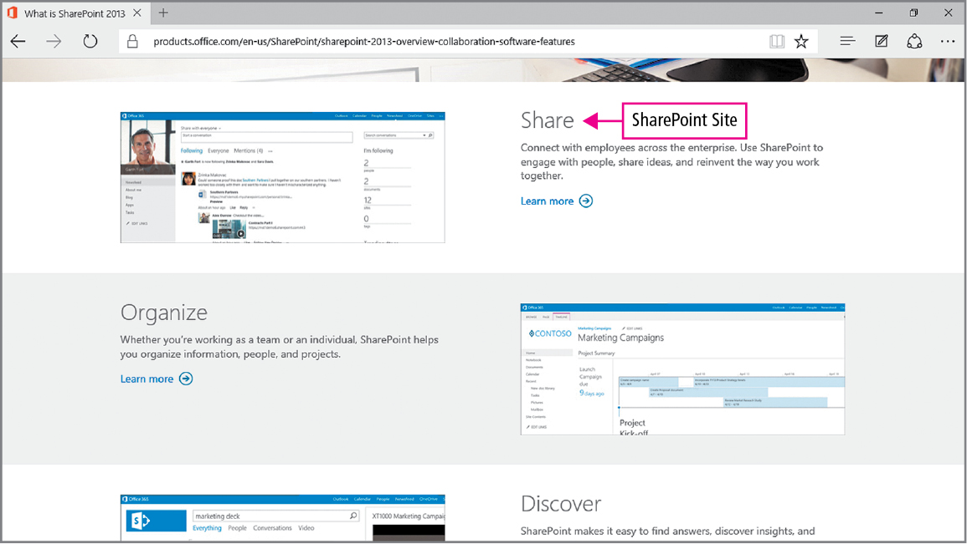
Concept 9: Office 365 (cont.)
Notes:
SharePoint is a web application server designed for organizations to develop an Intranet. Office 365 also provides a server that can host a public website, which is designed for public access.

Slide 39
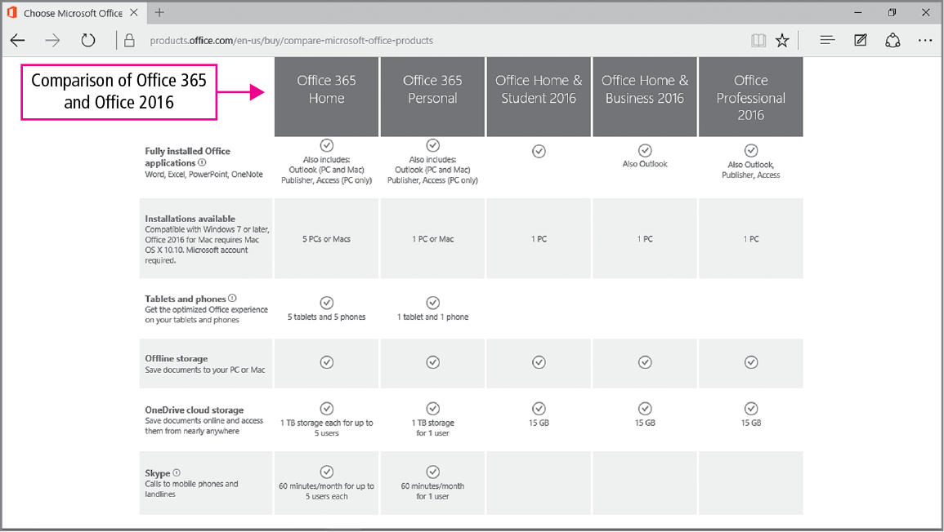
Concept 9: Office 365 (cont.)
Notes:
Office 365 allows for easy installation and use of Office on multiple devices with multiple users at multiple locations. When files are saved to OneDrive, access to that information will be available from any computer connected to the Internet.

Slide 40
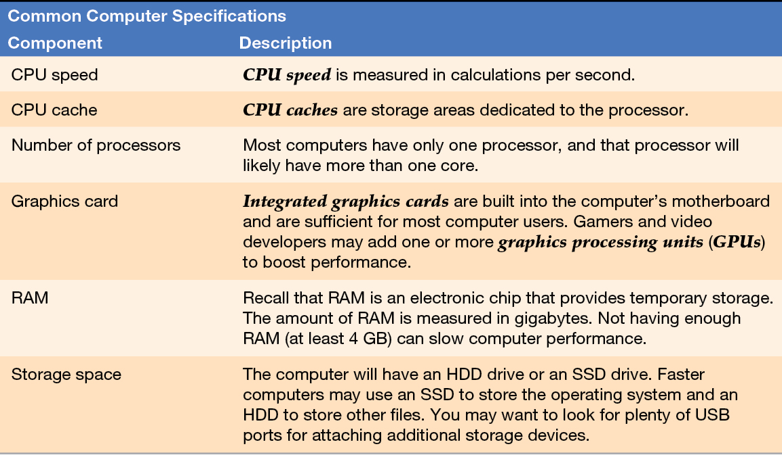
Concept 10: Buying a Computer
Notes:
Before deciding on the type of computer to purchase, you need to decide how it will be used. If you desire mobility, a laptop would be a best choice. If you plan to work only at your desk, the desktop will provide the most cost-effective and powerful computing power. Make sure that any hardware and software you want to use on your new computer will be compatible with your computer specifications.

Slide 41
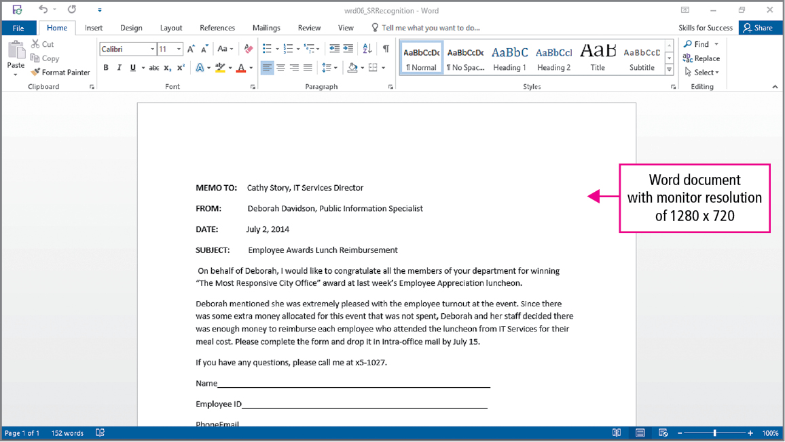
Concept 10: Buying a Computer (cont.)
Notes:
Because of small screen sizes, working with Office documents on tablets and smartphones can sometimes limit functionality.

Slide 42
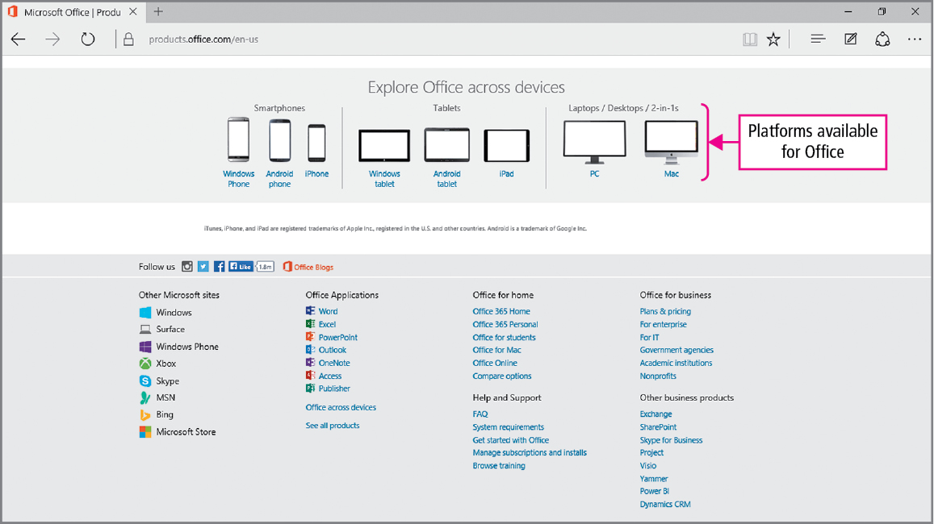
Concept 10: Buying a Computer (cont.)
Notes:
If you plan to run certain software or applications, make sure you have enough processing speed as recommended by the manufacturer, such as RAM, memory storage space, and gaming/graphics performance to run those programs smoothly.

Slide 43
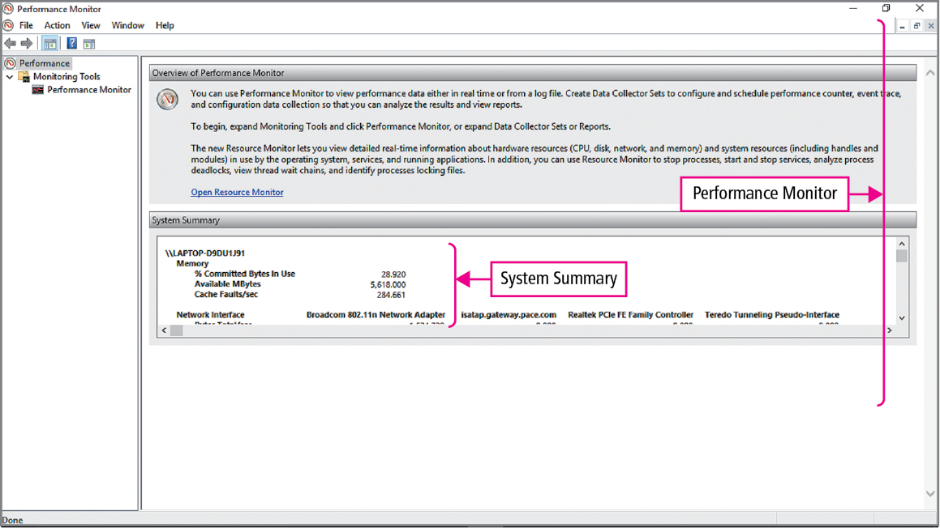
Concept 10: Buying a Computer (cont.)
Notes:
High-quality, fast computer games need far more computer power than standard applications. If you do not play games with 3-D graphics, you probably do not need a computer with a faster CPUs or higher graphics capabilities.

Slide 44
Summary
The computer is composed of hardware and software
Networks, the Internet, and the Cloud are parts of most computer systems
Understanding computers helps you solve problems, upgrade, or purchase a computer
Notes:
Computers require both hardware and software to function. Networks, the Internet, and the Cloud are now part of most computing systems. It is important to understand the basic function and operation of computers in order to solve problems, upgrade computer systems, or purchase a new computer.

Slide 45
Questions
Notes:
As you complete this introduction to general computer concepts, be sure you ask questions. You want to understand the concepts so that you can continue to build on them in future chapters.

Slide 46
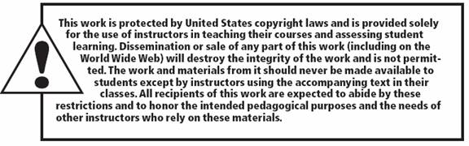
Copyright
All rights reserved. No part of this publication may be reproduced, stored in a retrieval system, or transmitted, in any form or by any means, electronic, mechanical, photocopying, recording, or otherwise, without the prior written permission of the publisher. Printed in the United States of America.

